Slide 1

COVID-19
GROUP 1
Debra Wu, Michael Bien, Jinah Porter, Lupita Lopez
Notes:
As you all know, Worldwide spread of the new SARS-CoV-2, also as known as COVID-19 and/or the coronavirus, led the World Health Organization (WHO) to designate the virus as a pandemic. As the pandemic evolves, different parts of the United States are experiencing different levels of COVID-19 disease. The COVID-19 has affected every part of the world in 2020, and the purpose of this project reflects in scopes and areas that COVID-19 has impacted (Age, Socio-economic factors related to GDP, Locations, Populations, etc.) by analyzing the data of COVID-19 from multiple sets.

Slide 2
—DR. TEDROS ADHANOM GHEBREYESUS
WORLD HEALTH ORGANIZATION’S DIRECTOR GENERAL
“As some countries start to open up we see cases and deaths starting to spike and concerns about potential lack of hospital capacity.
This is a critical moment for countries and we ask leaders to put targeted measures in place that we know can suppress the spread and ensure that health systems and workers are protected.”

Slide 3

Points of Analysis
Is there a relationship between COVID-19 deaths and the population, population density, and GDP at the global level?
Is there a relationship between COVID-19 deaths and the population, population density, and GDP in the U.S.?
Does the age demonstrate the COVID-19 death risk in the United States?
Does GDPs for each state have any relationships with COVID-19 related deaths?
How is gender impacted by Covid-19 deaths in the U.S.?
Notes:
Collectively as a team, we formulated these interesting questions to analysis:

Slide 4
01.
Data Sources

Slide 5







Data Exploration
Notes:
We wanted to gather the data that’s directly related to COVID-19 and merged them into the subjective data based on the analytical points for the project. For COVID-19, we pulled Johns Hopkins and CDC as the main source and added COVID-tracking and BEA (Bureau of Economic Analysis). For our external data sources, we used 1) The World Bank, 2) Wikipedia for the World, and U.S. Census for the United States.

Slide 6
Data: Assumptions & Limitations
The Data: Johns Hopkins vs. CDC
Lack of reliable data
No data reported for certain countries (eg. North Korea, Palestine)
Reporting & recording data inconsistencies between the Johns Hopkins data and the CDC data prevent us from comparing World vs. U.S.
Non-Political Stance
Intentionally not pulling data that could create political tension
Notes:
michael

Slide 7
01.
02.
A World In Crisis:
The World & COVID-19
A World In Crisis:
United States & COVID-19
03.
04.
A State of Emergency: The States & COVID-19
Age of Alarm: Age & Gender in U.S. & COVID-19

Slide 8
02.
ANALYSIS FINDINGS

Slide 9
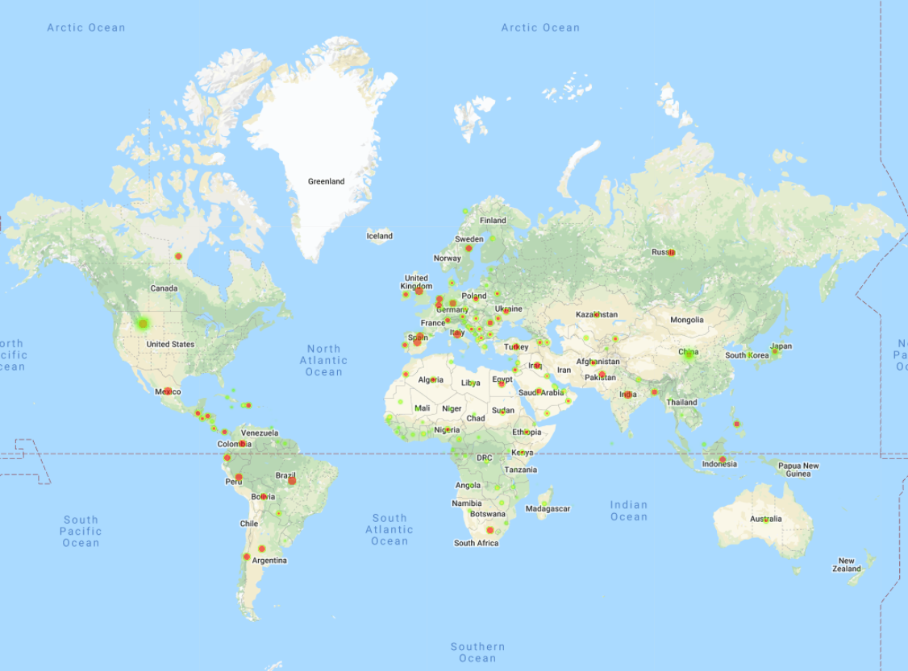
A World In Crisis: Deaths vs. GDP
1,132,288 deaths as of 09/21/2020
5
4
1
2
3
Deaths and GDP (100 Trillion)

Slide 10
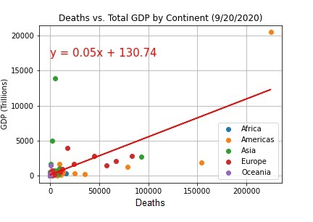
A World In Crisis: Deaths vs. GDP
r = 0.673702343176233
Observations:
There is a strong positive correlation between GDP and deaths
The Americas have experienced 51.6% of the global deaths, but these countries only represent 32.7% of the global GDP.

Slide 11
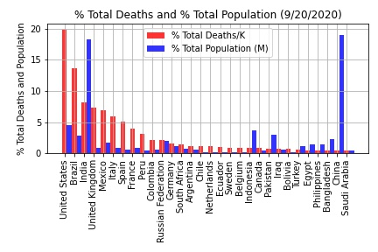
A World In Crisis: Deaths vs. Population
Observations:
There is no correlation between population and deaths
The United States has only ~5% of the world population and has 20% of the COVID deaths

Slide 12
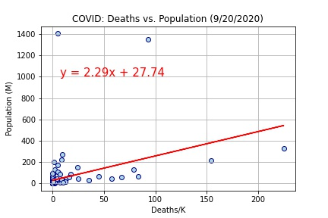
A World In Crisis: Deaths vs. Population
r = 0.36641957372944856
Observations:
There is not a strong correlation between deaths and population

Slide 13
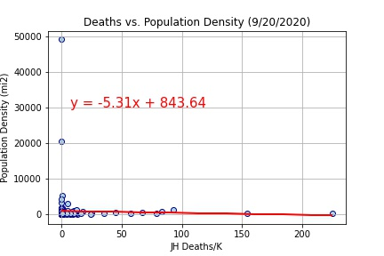
A World In Crisis: Deaths vs. Population Density
r = -0.03211284652098196
Observations:
There is absolutely no correlation between deaths and population density
Islands are the most population-dense countries and do not have a significant portion of the global deaths

Slide 14
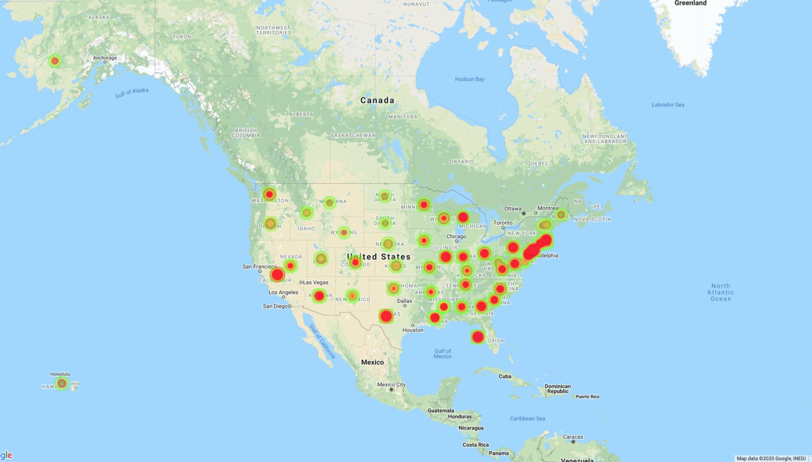
A State of Emergency: Deaths vs GDP
Deaths and GDP (Million)

Slide 15
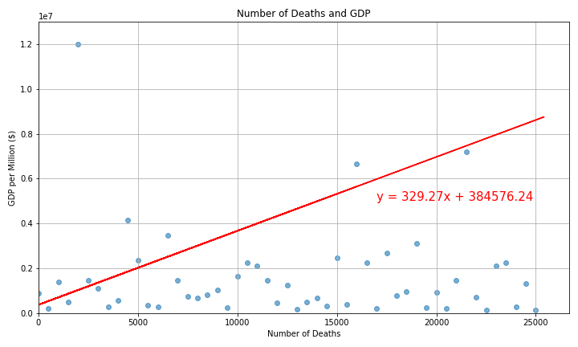
A State of Emergency: Deaths vs. GDP
Observations:
As GDP grows, so does the number of deaths in each State
The expectation of a negative correlation is proven wrong
r = 0.8095835180978503

Slide 16
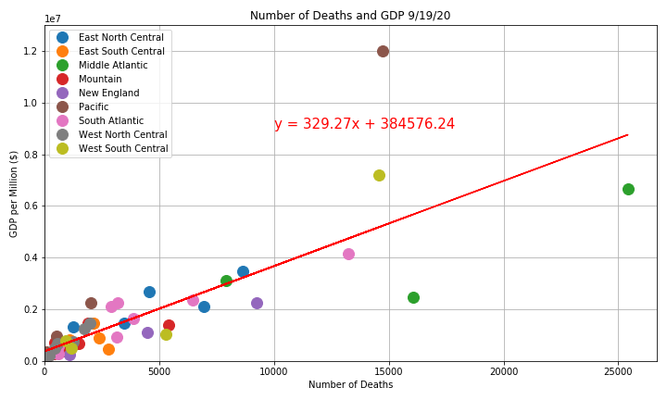
A State of Emergency: Deaths vs. GDP
Observations:
Further illustrated with States per region’s GDP and death rate
r = 0.8095835180978503

Slide 17
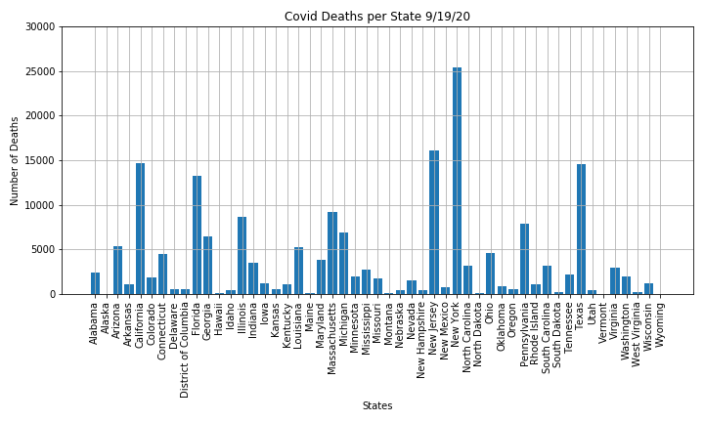
A State of Emergency: Deaths
Observations:
New York & New Jersey have the highest amount of deaths
Alaska, Hawaii, Montana, Vermont & Wyoming have the least amount of deaths

Slide 18
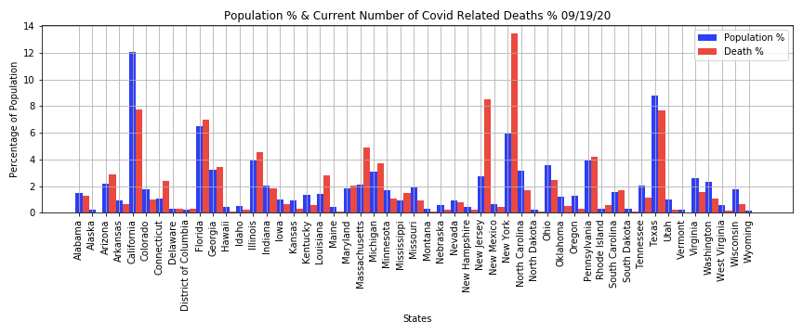
A State of Emergency: Deaths vs. Population
Observations:
There is no strong relationship between population and Covid related death percentages
New York falls the highest in deaths, and is in the top 5 in population

Slide 19
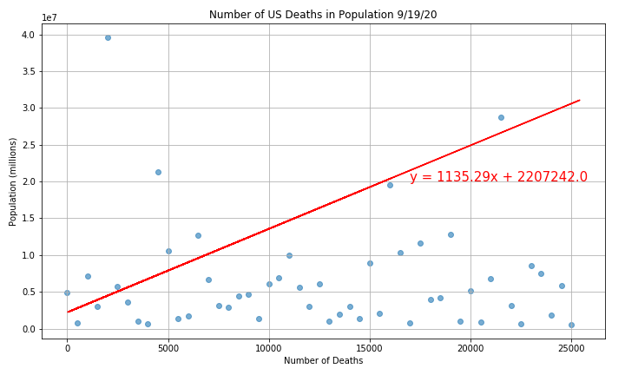
A State of Emergency: Deaths vs. Population
Observations:
High r-value between deaths & population, notes a high positive linear relationship
r = 0.7947568502966617
Notes:
This could be related to overcrowding at hospitals and lack of resources in hospitals

Slide 20
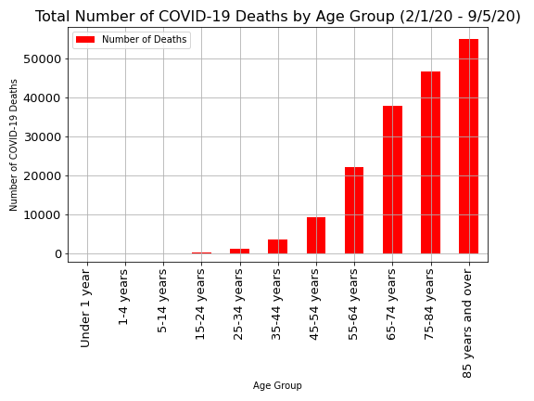
Age of Emergency: Deaths and Age Group
Observations:
The children under 14 has much lower death rate (0.03%)
Adults age 65 and above contains approx. 80% of the deaths
Notes:
Adding more factors to COVID-19 deaths, we wanted to analyze the relationship between COVID-19 deaths and the age group, since the media has been raising the concern of COVID-19’s vulnerability risk among people who are older. Based on CDC data, approximately 80% of the COVID-19 deaths are from adults age 65 years and older. In contrast, the age group of children age 14 and under has a significantly low death rate (approx. 0.03%) in the last 7 months of this Pandemic period.

Slide 21
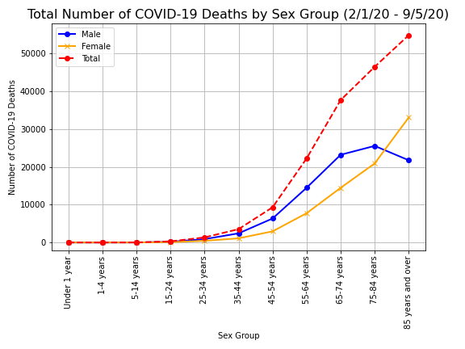
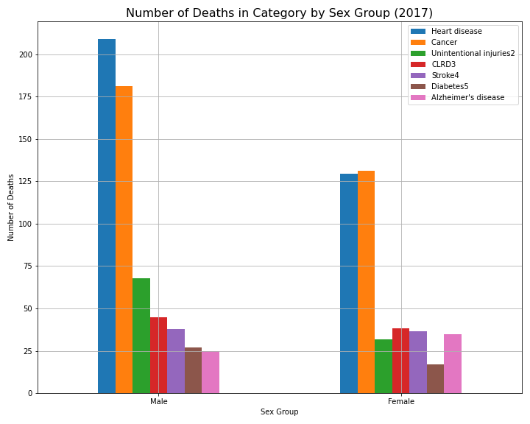
Age of Alarm: Deaths and Gender
Notes:
Our study in COVID-19 deaths in relation to gender indicates that men face a higher risk of death from COVID-19 than women across the age group from newborns to 84 years. This led to two questions, which are: 1) Is there a similar pattern between COVID-19 deaths in gender and other deaths (i.e., cancer, diabetes, heart diseases, etc.) in gender?, and 2) Why?
In order to answer the first question, we pulled another data from CDC; the number of deaths in top 7 causes in the United States by gender. It’s interesting to find out that the male group contains a higher number of deaths for heart diseases, cancer, unintentional injuries, chronic lower respiratory disease, stroke and diabetes compared to female.
As far as answering “why?” -- we were not able to find the direct correlation between the cause and effect; however, we could make an argument based on the CDC statistics that there is a correlation between the percentage of tobacco product use and deaths rate, since there are 25.8% of men in the United States saying yes to tobacco product use, compared to women in 14.1%.
Men: 25.8 %
Women: 14.1%

Slide 22



THANKS!
Stay safe by wearing masks and washing your hands!
Any questions?

